Slide 1
Ismail Ayman
Welcome
<
>
\

Slide 2
02
03
04
01
1
Players
Load and save
Welcome
get_words
gridy
2
This function asks the user whether to play singleplayer , multiplayer either versus player or a computer calculate the player score based on their performance in the word search game . It typically takes inputs such as if the word is found . For every correctly identified word ,a predefined number of points awarded .The function provide live feedback based on the user and the other player and even the computer score .
Thes functions work together to enable seamless saving and loading of the multiplayer’s or single player states ,score ,names,words and even the grid allowing the user to save and load the game whenever they want .
This Python function reads words from three text files : countries .txt,animals.txt , and fruits .txt . It stores each word in a list by its category .
Then finally , choosing 10 random words from the choosed category from the user
This function place words into a 10x10 matrix either horizontally , vertically , or diagonally , For each word ,it randomly selects a direction and attempts to place the word in the grid while ensuring no over laps with existing letters . If successful the word is added otherwise , it retries until the placement is completed .After all words are placed ,any empty cells in the grid will be filled with a random capitalized letter .Finally the complete matrix is printed showing the words randomly added to the grid .
3
<
>
4
\
CODE WARRIORS

Slide 3
02
03
04
# WORD SEARCH GAME
01
1
Players
Load and save
get_words
#
gridy
2
This function asks the user whether to play singleplayer , multiplayer either versus player or a computer calculate the player score based on their performance in the word search game . It typically takes inputs such as if the word is found . For every correctly identified word ,a predefined number of points awarded .The function provide live feedback based on the user and the other player and even the computer score .
Thes functions work together to enable seamless saving and loading of the multiplayer’s or single player states ,score ,names,words and even the grid allowing the user to save and load the game whenever they want .
4 main Ideas
11 Functions
This Python function reads words from three text files : countries .txt,animals.txt , and fruits .txt . It stores each word in a list by its category .
Then finally , choosing 10 random words from the choosed category from the user
This function place words into a 10x10 matrix either horizontally , vertically , or diagonally , For each word ,it randomly selects a direction and attempts to place the word in the grid while ensuring no over laps with existing letters . If successful the word is added otherwise , it retries until the placement is completed .After all words are placed ,any empty cells in the grid will be filled with a random capitalized letter .Finally the complete matrix is printed showing the words randomly added to the grid .
3
{ }
4

Slide 4
02
03
04
01
1
Players
Load and save
get_words
gridy
2
This function asks the user whether to play singleplayer , multiplayer either versus player or a computer calculate the player score based on their performance in the word search game . It typically takes inputs such as if the word is found . For every correctly identified word ,a predefined number of points awarded .The function provide live feedback based on the user and the other player and even the computer score .
Thes functions work together to enable seamless saving and loading of the multiplayer’s or single player states ,score ,names,words and even the grid allowing the user to save and load the game whenever they want .
This function place words into a 10x10 matrix either horizontally , vertically , or diagonally , For each word ,it randomly selects a direction and attempts to place the word in the grid while ensuring no over laps with existing letters . If successful the word is added otherwise , it retries until the placement is completed .After all words are placed ,any empty cells in the grid will be filled with a random capitalized letter .Finally the complete matrix is printed showing the words randomly added to the grid .
3
This Python function reads words from three text files : countries .txt,animals.txt , and fruits .txt . It stores each word in a list by its category .
Then finally , choosing 10 random words from the choosed category from the user
4

Slide 5
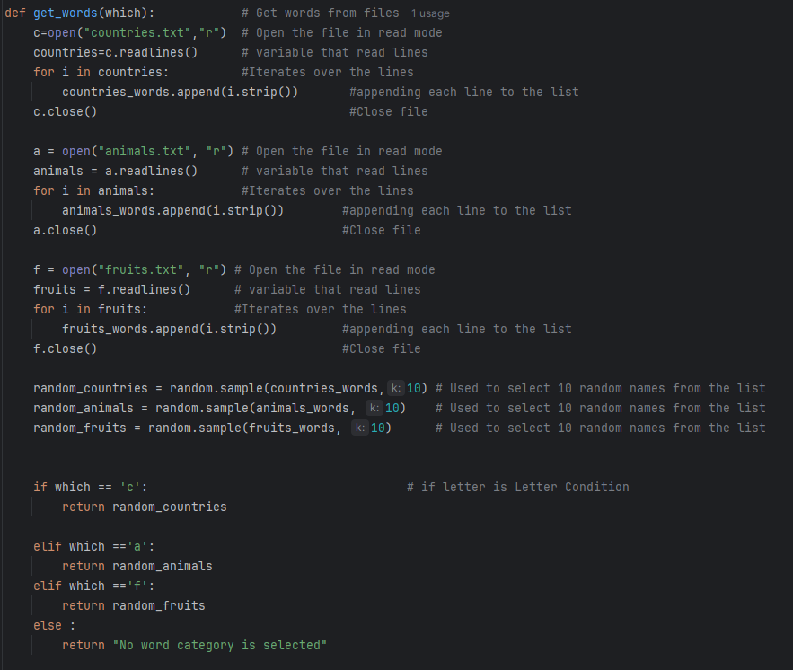
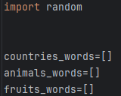
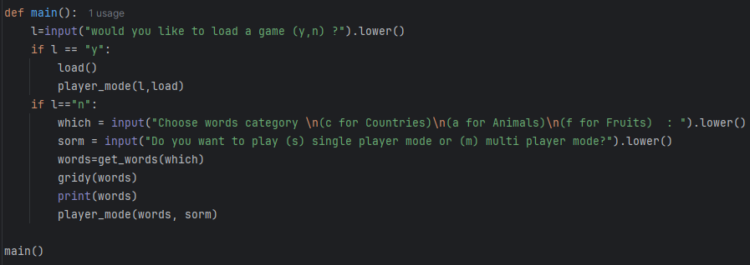
04

Slide 6
02
03
04
01
1
Players
Load and save
get_words
gridy
2
This function asks the user whether to play singleplayer , multiplayer either versus player or a computer calculate the player score based on their performance in the word search game . It typically takes inputs such as if the word is found . For every correctly identified word ,a predefined number of points awarded .The function provide live feedback based on the user and the other player and even the computer score .
Thes functions work together to enable seamless saving and loading of the multiplayer’s or single player states ,score ,names,words and even the grid allowing the user to save and load the game whenever they want .
This function place words into a 10x10 matrix either horizontally , vertically , or diagonally , For each word ,it randomly selects a direction and attempts to place the word in the grid while ensuring no over laps with existing letters . If successful the word is added otherwise , it retries until the placement is completed .After all words are placed ,any empty cells in the grid will be filled with a random capitalized letter .Finally the complete matrix is printed showing the words randomly added to the grid .
3
This Python function reads words from three text files : countries .txt,animals.txt , and fruits .txt . It stores each word in a list by its category .
Then finally , choosing 10 random words from the choosed category from the user
4

Slide 7
02
03
04
01
1
Players
Load and save
get_words
gridy
2
This function asks the user whether to play singleplayer , multiplayer either versus player or a computer calculate the player score based on their performance in the word search game . It typically takes inputs such as if the word is found . For every correctly identified word ,a predefined number of points awarded .The function provide live feedback based on the user and the other player and even the computer score .
Thes functions work together to enable seamless saving and loading of the multiplayer’s or single player states ,score ,names,words and even the grid allowing the user to save and load the game whenever they want .
This Python function reads words from three text files : countries .txt,animals.txt , and fruits .txt . It stores each word in a list by its category .
Then finally , choosing 10 random words from the choosed category from the user
This function place words into a 10x10 matrix either horizontally , vertically , or diagonally , For each word ,it randomly selects a direction and attempts to place the word in the grid while ensuring no over laps with existing letters . If successful the word is added otherwise , it retries until the placement is completed .After all words are placed ,any empty cells in the grid will be filled with a random capitalized letter .Finally the complete matrix is printed showing the words randomly added to the grid .
3
4

Slide 8
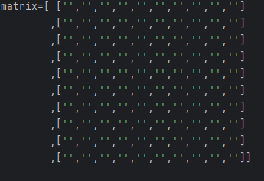
03

Slide 9
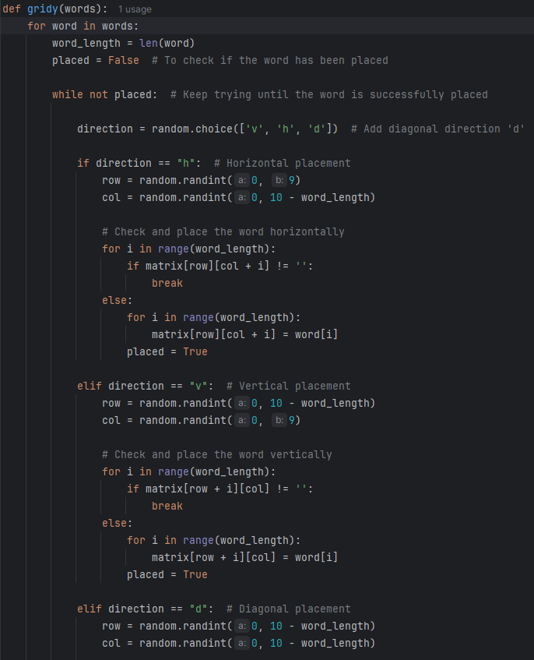
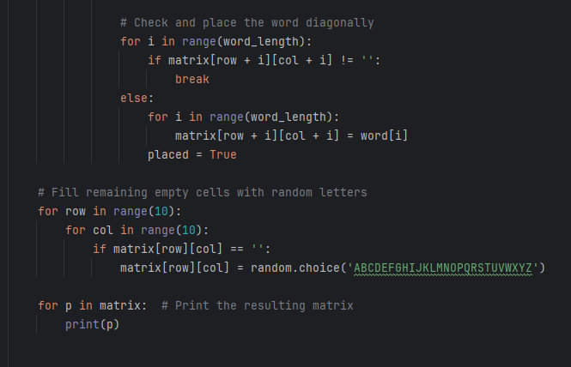
03

Slide 10
02
03
04
01
1
Players
Load and save
get_words
gridy
2
This function asks the user whether to play singleplayer , multiplayer either versus player or a computer calculate the player score based on their performance in the word search game . It typically takes inputs such as if the word is found . For every correctly identified word ,a predefined number of points awarded .The function provide live feedback based on the user and the other player and even the computer score .
Thes functions work together to enable seamless saving and loading of the multiplayer’s or single player states ,score ,names,words and even the grid allowing the user to save and load the game whenever they want .
This Python function reads words from three text files : countries .txt,animals.txt , and fruits .txt . It stores each word in a list by its category .
Then finally , choosing 10 random words from the choosed category from the user
This function place words into a 10x10 matrix either horizontally , vertically , or diagonally , For each word ,it randomly selects a direction and attempts to place the word in the grid while ensuring no over laps with existing letters . If successful the word is added otherwise , it retries until the placement is completed .After all words are placed ,any empty cells in the grid will be filled with a random capitalized letter .Finally the complete matrix is printed showing the words randomly added to the grid .
3
4

Slide 11
02
03
04
01
1
Players
Load and save
get_words
gridy
2
Thes functions work together to enable seamless saving and loading of the multiplayer’s or single player states ,score ,names,words and even the grid allowing the user to save and load the game whenever they want .
This function asks the user whether to play singleplayer , multiplayer either versus player or a computer calculate the player score based on their performance in the word search game . It typically takes inputs such as if the word is found . For every correctly identified word ,a predefined number of points awarded .The function provide live feedback based on the user and the other player and even the computer score .
This Python function reads words from three text files : countries .txt,animals.txt , and fruits .txt . It stores each word in a list by its category .
Then finally , choosing 10 random words from the choosed category from the user
This function place words into a 10x10 matrix either horizontally , vertically , or diagonally , For each word ,it randomly selects a direction and attempts to place the word in the grid while ensuring no over laps with existing letters . If successful the word is added otherwise , it retries until the placement is completed .After all words are placed ,any empty cells in the grid will be filled with a random capitalized letter .Finally the complete matrix is printed showing the words randomly added to the grid .
3
4

Slide 12
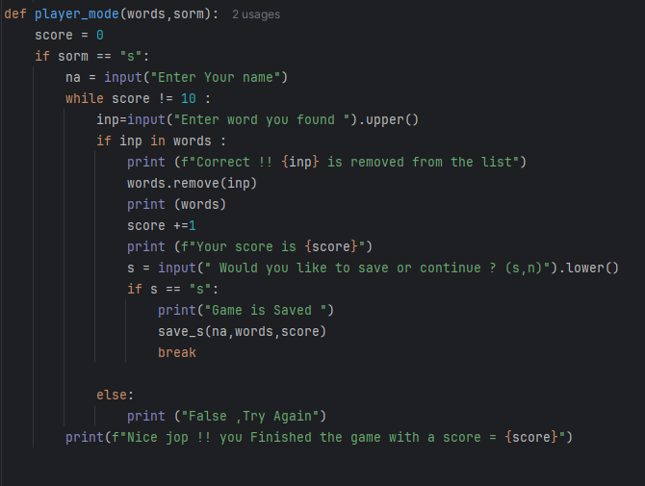
02

Slide 13
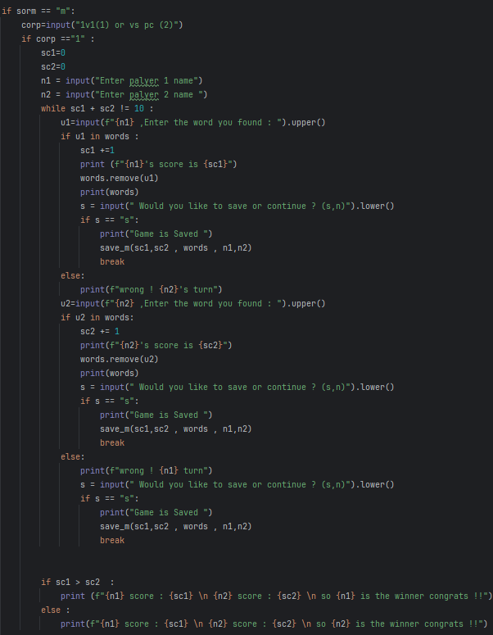
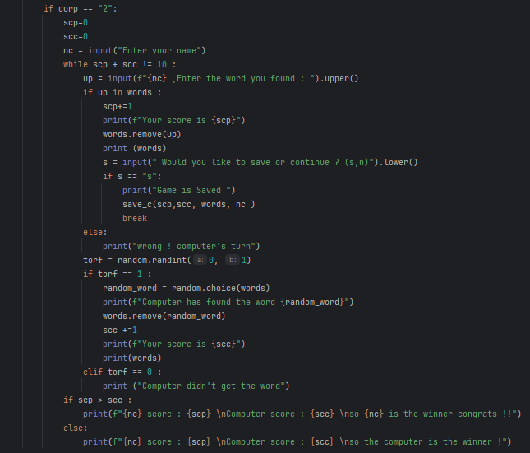
02

Slide 14
02
03
04
01
1
Players
Load and save
get_words
gridy
2
Thes functions work together to enable seamless saving and loading of the multiplayer’s or single player states ,score ,names,words and even the grid allowing the user to save and load the game whenever they want .
This function asks the user whether to play singleplayer , multiplayer either versus player or a computer calculate the player score based on their performance in the word search game . It typically takes inputs such as if the word is found . For every correctly identified word ,a predefined number of points awarded .The function provide live feedback based on the user and the other player and even the computer score .
This Python function reads words from three text files : countries .txt,animals.txt , and fruits .txt . It stores each word in a list by its category .
Then finally , choosing 10 random words from the choosed category from the user
This function place words into a 10x10 matrix either horizontally , vertically , or diagonally , For each word ,it randomly selects a direction and attempts to place the word in the grid while ensuring no over laps with existing letters . If successful the word is added otherwise , it retries until the placement is completed .After all words are placed ,any empty cells in the grid will be filled with a random capitalized letter .Finally the complete matrix is printed showing the words randomly added to the grid .
3
4

Slide 15
02
03
04
01
1
Players
Load and save
get_words
gridy
2
This function asks the user whether to play singleplayer , multiplayer either versus player or a computer calculate the player score based on their performance in the word search game . It typically takes inputs such as if the word is found . For every correctly identified word ,a predefined number of points awarded .The function provide live feedback based on the user and the other player and even the computer score .
Thes functions work together to enable seamless saving and loading of the multiplayer’s or single player states ,score ,names,words and even the grid allowing the user to save and load the game whenever they want .
This Python function reads words from three text files : countries .txt,animals.txt , and fruits .txt . It stores each word in a list by its category .
Then finally , choosing 10 random words from the choosed category from the user
This function place words into a 10x10 matrix either horizontally , vertically , or diagonally , For each word ,it randomly selects a direction and attempts to place the word in the grid while ensuring no over laps with existing letters . If successful the word is added otherwise , it retries until the placement is completed .After all words are placed ,any empty cells in the grid will be filled with a random capitalized letter .Finally the complete matrix is printed showing the words randomly added to the grid .
3
4

Slide 16
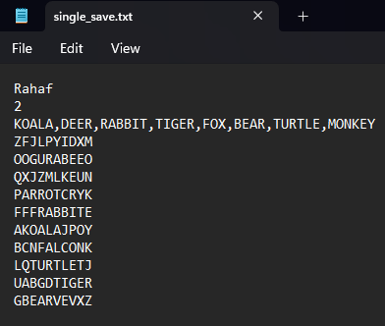
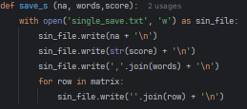
01

Slide 17
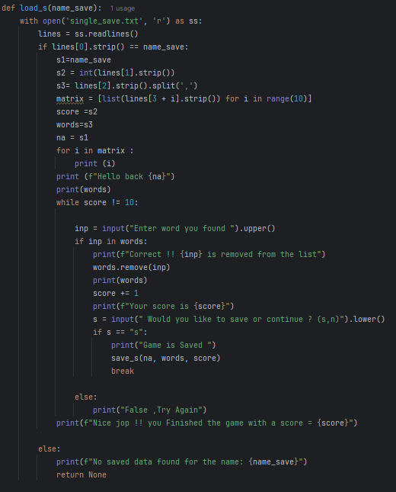
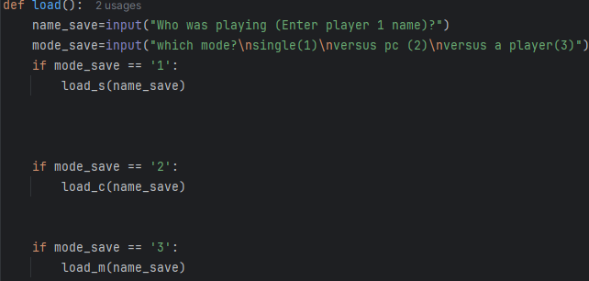
01

Slide 18
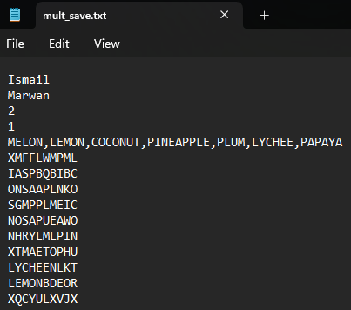
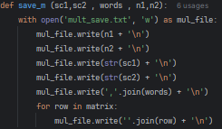
01

Slide 19
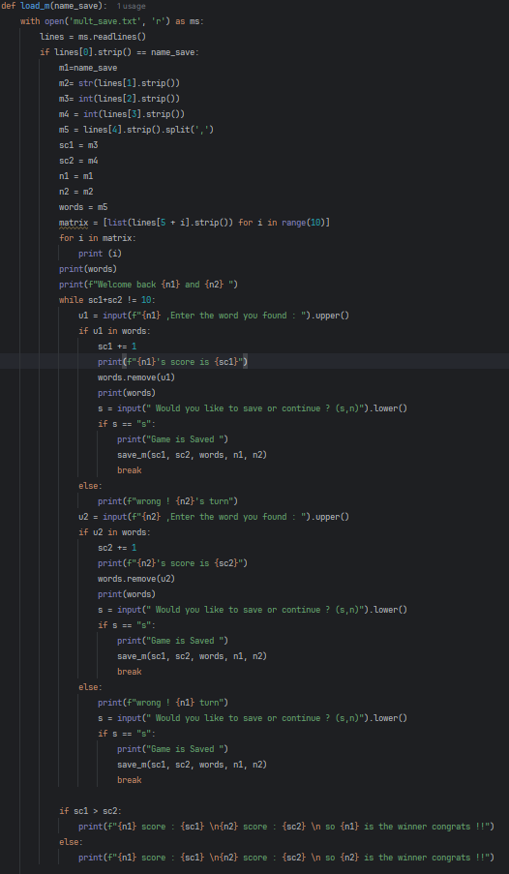

01

Slide 20
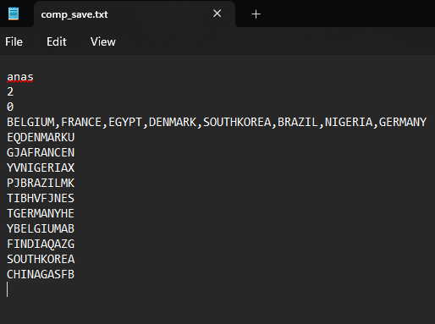
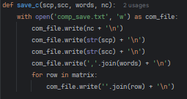
01

Slide 21
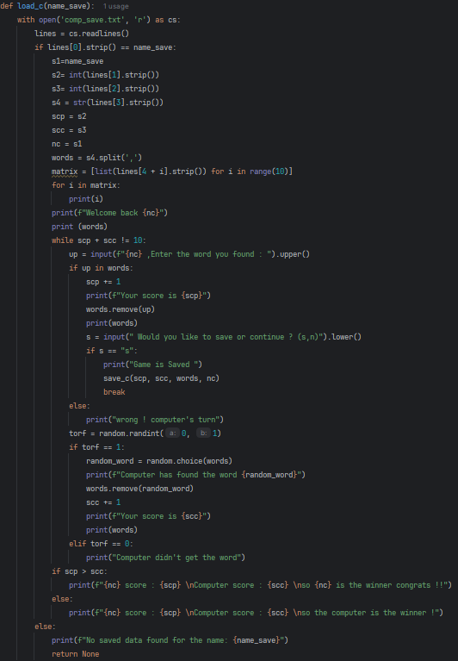
01

Slide 22
02
03
04
01
1
Players
Load and save
get_words
gridy
2
This function asks the user whether to play singleplayer , multiplayer either versus player or a computer calculate the player score based on their performance in the word search game . It typically takes inputs such as if the word is found . For every correctly identified word ,a predefined number of points awarded .The function provide live feedback based on the user and the other player and even the computer score .
Thes functions work together to enable seamless saving and loading of the multiplayer’s or single player states ,score ,names,words and even the grid allowing the user to save and load the game whenever they want .
This Python function reads words from three text files : countries .txt,animals.txt , and fruits .txt . It stores each word in a list by its category .
Then finally , choosing 10 random words from the choosed category from the user
This function place words into a 10x10 matrix either horizontally , vertically , or diagonally , For each word ,it randomly selects a direction and attempts to place the word in the grid while ensuring no over laps with existing letters . If successful the word is added otherwise , it retries until the placement is completed .After all words are placed ,any empty cells in the grid will be filled with a random capitalized letter .Finally the complete matrix is printed showing the words randomly added to the grid .
3
4

Slide 23
02
03
04
01
1
Players
Load and save
Thanks For listening
get_words
gridy
2
This function asks the user whether to play singleplayer , multiplayer either versus player or a computer calculate the player score based on their performance in the word search game . It typically takes inputs such as if the word is found . For every correctly identified word ,a predefined number of points awarded .The function provide live feedback based on the user and the other player and even the computer score .
Thes functions work together to enable seamless saving and loading of the multiplayer’s or single player states ,score ,names,words and even the grid allowing the user to save and load the game whenever they want .
This Python function reads words from three text files : countries .txt,animals.txt , and fruits .txt . It stores each word in a list by its category .
Then finally , choosing 10 random words from the choosed category from the user
This function place words into a 10x10 matrix either horizontally , vertically , or diagonally , For each word ,it randomly selects a direction and attempts to place the word in the grid while ensuring no over laps with existing letters . If successful the word is added otherwise , it retries until the placement is completed .After all words are placed ,any empty cells in the grid will be filled with a random capitalized letter .Finally the complete matrix is printed showing the words randomly added to the grid .
3
<
>
4
\
CODE WARRIORS

Slide 24
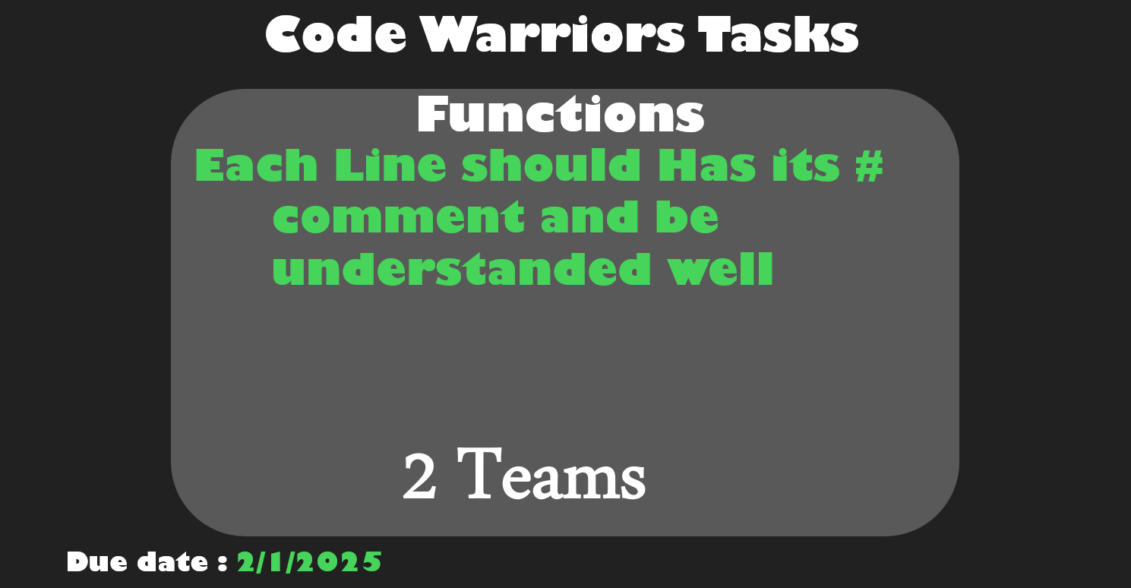

Slide 25
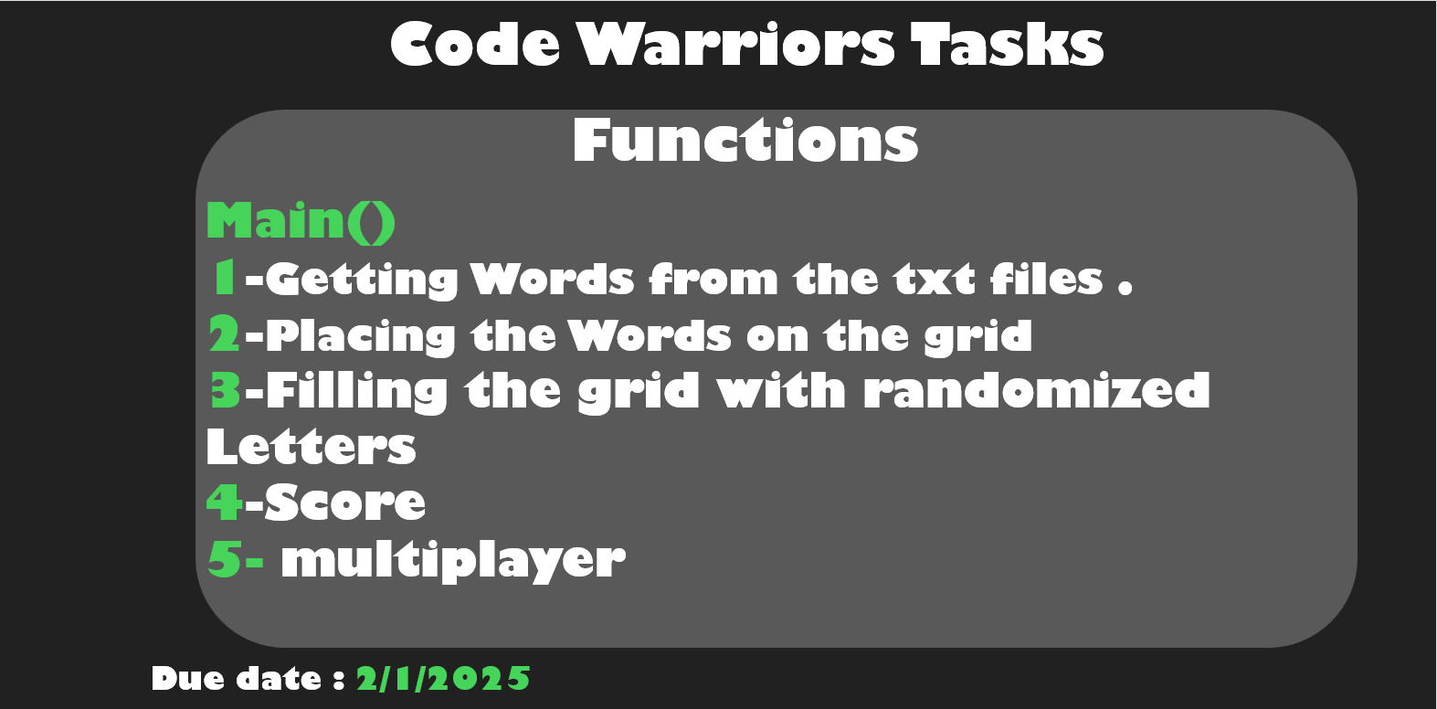

Slide 26
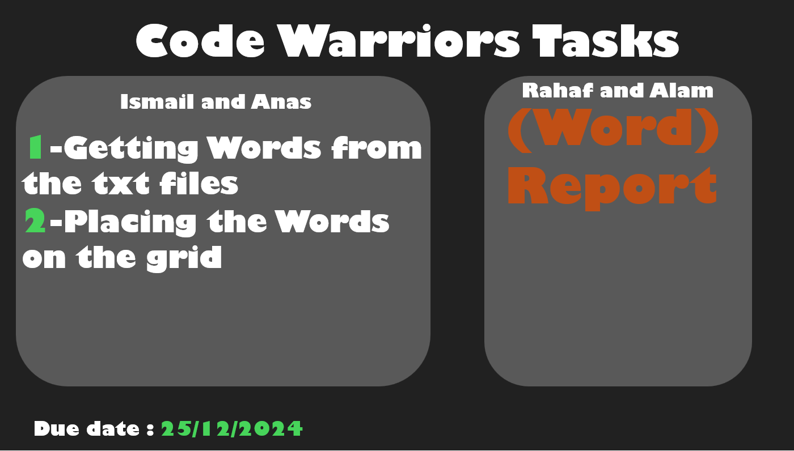

Slide 27
